Slide 1
MINIMIZING FERTILIZER WASTAGE: A SOIL-BASED APPROACH TO EFFICIENT NUTRIENT MANAGEMENT
RESEARCH AREA:AGRICULTURE
KIPROTICH PHILIP
2021/BIT/077/PS
Faculty of Computing and Informatics
[Department of Information Technology]
Notes:
1

Slide 2
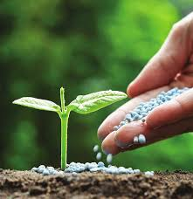
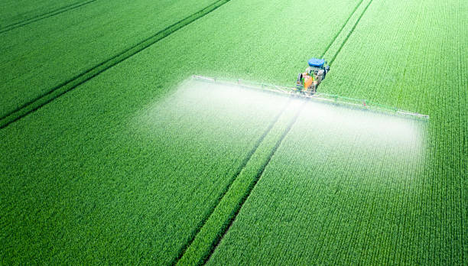
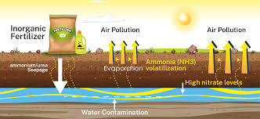
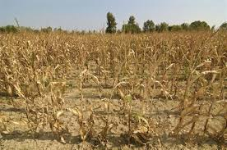
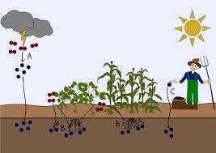
Introduction /Background
Fertilizer application is crucial for crop growth but excessive use leads to environmental and economic challenges.
Fertilizer wastage occurs when nutrients are applied in excess or not readily available to plants leading to pollution and climate change.
Excess fertilizer use can cause nutrient imbalances in the soil, affecting crop health and productivity.

Slide 3
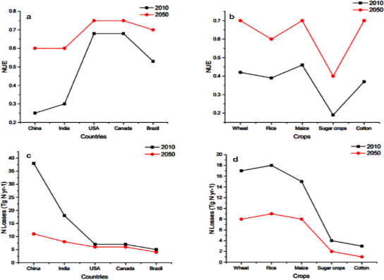
Problem Statement
“Farmers are using fertilizers in a way that wastes a lot of them. This is bad for the environment and it costs farmers money. According to AgroCares Agronomist, Christy Van Beek says Uganda just like other African countries waste 30-50% of nitrogen fertilizers, 20-30% of phosphorus and 50-70% of potassium. This means the country will continue to loose nutrients and this threatens its resource base.
Who is affected?
Farmers: They loose money because they are buying fertilizers that they don’t need.
Environment: Fertilizer waste pollutes the air, water and cause climate change.
Consumers:
Fertilizer waste can make food expensive.
Why should we care?
It is a problem that affects everyone. By using fertilizers more efficiently, we can help farmers save money, protect environment and keep food prices down.

Slide 4
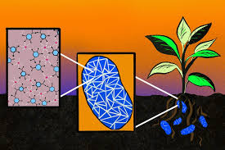
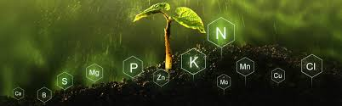
Main Objective
To minimize excessive fertilizer application which leads to wastage, by using a location specific soil fertility tester.

Slide 5
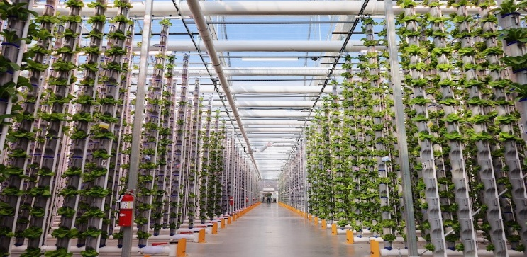

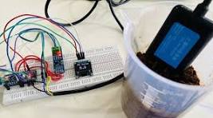
Specific objectives
To review existing technologies and practices used to avoid excessive fertilizer wastage, identify gaps and opportunities for improvement.
To conduct soil testing and pH analysis to determine nutrient availability in different portions of farmland and develop a database of soil nutrient compositions.
To develop a soil fertility testing tool which provides farmers with recommendations for fertilizer application based on soil Ph.

Slide 6
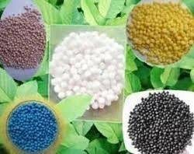
Significance of the study
ECONOMIC BENEFITS
Using precision fertilizer application based on soil testing lead to cost savings for farmers by avoiding unnecessary fertilizer purchases and improving crop productivity.
EFFICIENT NUTRIENT MANAGEMENT
Identifying areas where nutrients are lacking and recommending appropriate fertilizer combinations.
ENVIRONMENTAL SUSTAINABILITY
Reducing excessive fertilizer application, the project helps lessen nutrient pollution, water contamination associated with fertilizer production and runoff.
It promotes sustainable agriculture practices that protect soil health and water quality.
POLICY IMPLICATIONS
Provides valuable evidence to support regulations and rewards that encourage responsible fertilizer use and promote sustainable farming practices.

Slide 7
Literature Review
STUDY | METHOD USED | STRENGTH | GAP | FOCUS
Precision agriculture GAO-24-105962. | -Remote sensing -In-ground sensors -Targeted spray systems | -Increased profits for farmers by improving input use and achieving high yields. -Reduced application of crop inputs promoting resource efficiency. | Farmers may have tools, such as yield monitors, to identify outcomes of decisions, but few analytic tools and software are available to improve analysis and translate farm data into actionable decisions. | Help agricultural sector meet increasing demand for food products, while also helping farmers improve efficiencies such as through reduced input costs.
Nanofertilizers | -Foliar spray -Seed nanopriming -Soil treatment. | Has the potential to maximize crop yields due to the direct delivery of essential nutrients to plants but also decrease the environmental effects of fertilizers | -Lacked integration of nanosensors into nanofertilizers for current soil nutrient level and application. -Limited investigation of potential risks to humans, environment and soil organisms. | Addressed the challenges associated conventional fertilizers which suffer from low nutrient utilization due to leaching.
Vertical farming. | Hydroponic vertical farming | Farmers can use 98% less water, 99% less land and produce 240 times crop yields than traditional farms thought the year. | Lacked sensing technologies to monitor nutrient levels and plant health to enable adjustments to nutrient application. | To solve the problem of increasing food shortages in deserts and highly populated areas lacking access to fresh foods like fruits and vegetables.

Slide 8

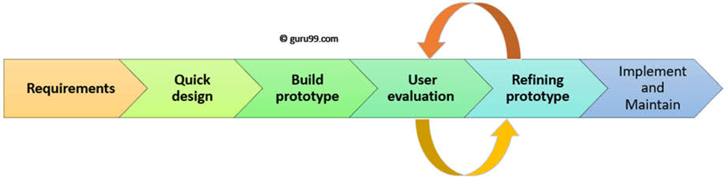
Methodology

Slide 9
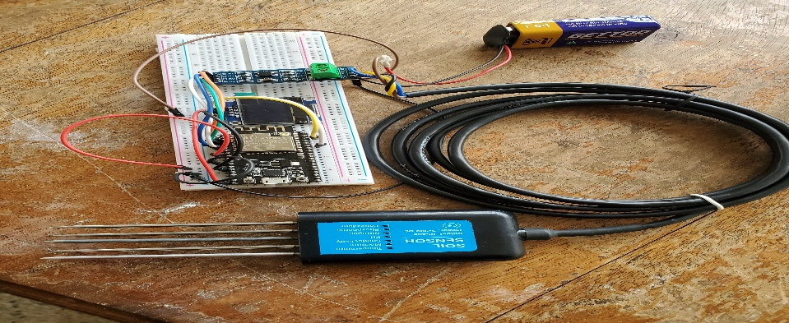
Progress made..
Components.
pH sensor (RS485), Esp32 module (microcontroller), OLED display, Breadboard, jumper wires, 9v power supply, TTL converter.
Progress:
All of the components have been connected together and the system is functional.
The system is able to accurately measure the pH of soil and display the results on the OLED module.
The system is portable and can be used in the field.

Slide 10
References
Precision Agriculture https://www.gao.gov/products/gao-24-105962
Abdalla, Z.F.; El-Sawy, S.; El-Bassiony, A.E.-M.; Jun, H.; Shedeed, S.; Okasha, A.M.; Bayoumi, Y.; El-Ramady, H.; Prokisch, J. Smart Fertilizers vs. Nano-fertilizers: A Pictorial Overview. Environ. Biodivers. Soil Secur. 2022, 6, 191–204. [Google Scholar] [CrossRef]
Gaur, M.; Misra, C.; Yadav, A.B.; Swaroop, S.; Maolmhuaidh, F.Ó.; Bechelany, M.; Barhoum, A. Biomedical applications of carbon nanomaterials: Fullerenes, quantum dots, nanotubes, nanofibers, and graphene. Materials 2021, 14, 5978. [Google Scholar] [CrossRef] [PubMed]
https://www.mdpi.com/2813-3145/2/2/19
https://www.edengreen.com/blog-collection/what-is-vertical-farming
https://www.mdpi.com/2073-4395/12/1/2
Son, J.E.; Kim, H.J.; Ahn, T.I. Hydroponic Systems. In Plant Factory; Elsevier: Amsterdam, The Netherlands, 2016; pp. 213–221. [Google Scholar]
Allegaert, S.D. The Vertical Farm Industry: Exploratory Research of a Wicked Situation; Wageningen University and Research: Wageningen, The Netherlands, 2020. [Google Scholar]
www.feedthefuture.gov

Slide 11



